Slide 1
Selenium
Internal Use - Confidential

Slide 2
Selenium
Mobile
Android/IOS
Selenium
Desktop
Win 10
Web Applications

Slide 3
Selenium Overview
It is Cross Platform.
It is Cross Browser.
It support parallel execution.
It support any kind of Web Application.
It support parallel execution in different machines/Platforms.

Slide 4
Selenium Drivers
Drivers:
Chrome Driver - http://chromedriver.chromium.org/downloads
Firefox Driver(Gecko) - https://github.com/mozilla/geckodriver/releases
IE Driver - https://www.seleniumhq.org/download/
Edge Driver - https://developer.microsoft.com/en-us/microsoft-edge/tools/webdriver/

Slide 5
Selenium Locators
ID
Link Text
Name
Class Name
Partial Link Text
CSS Selector
Tag Name
XPath
Contains()
Using OR & AND
Start-with function
Text()

Slide 6
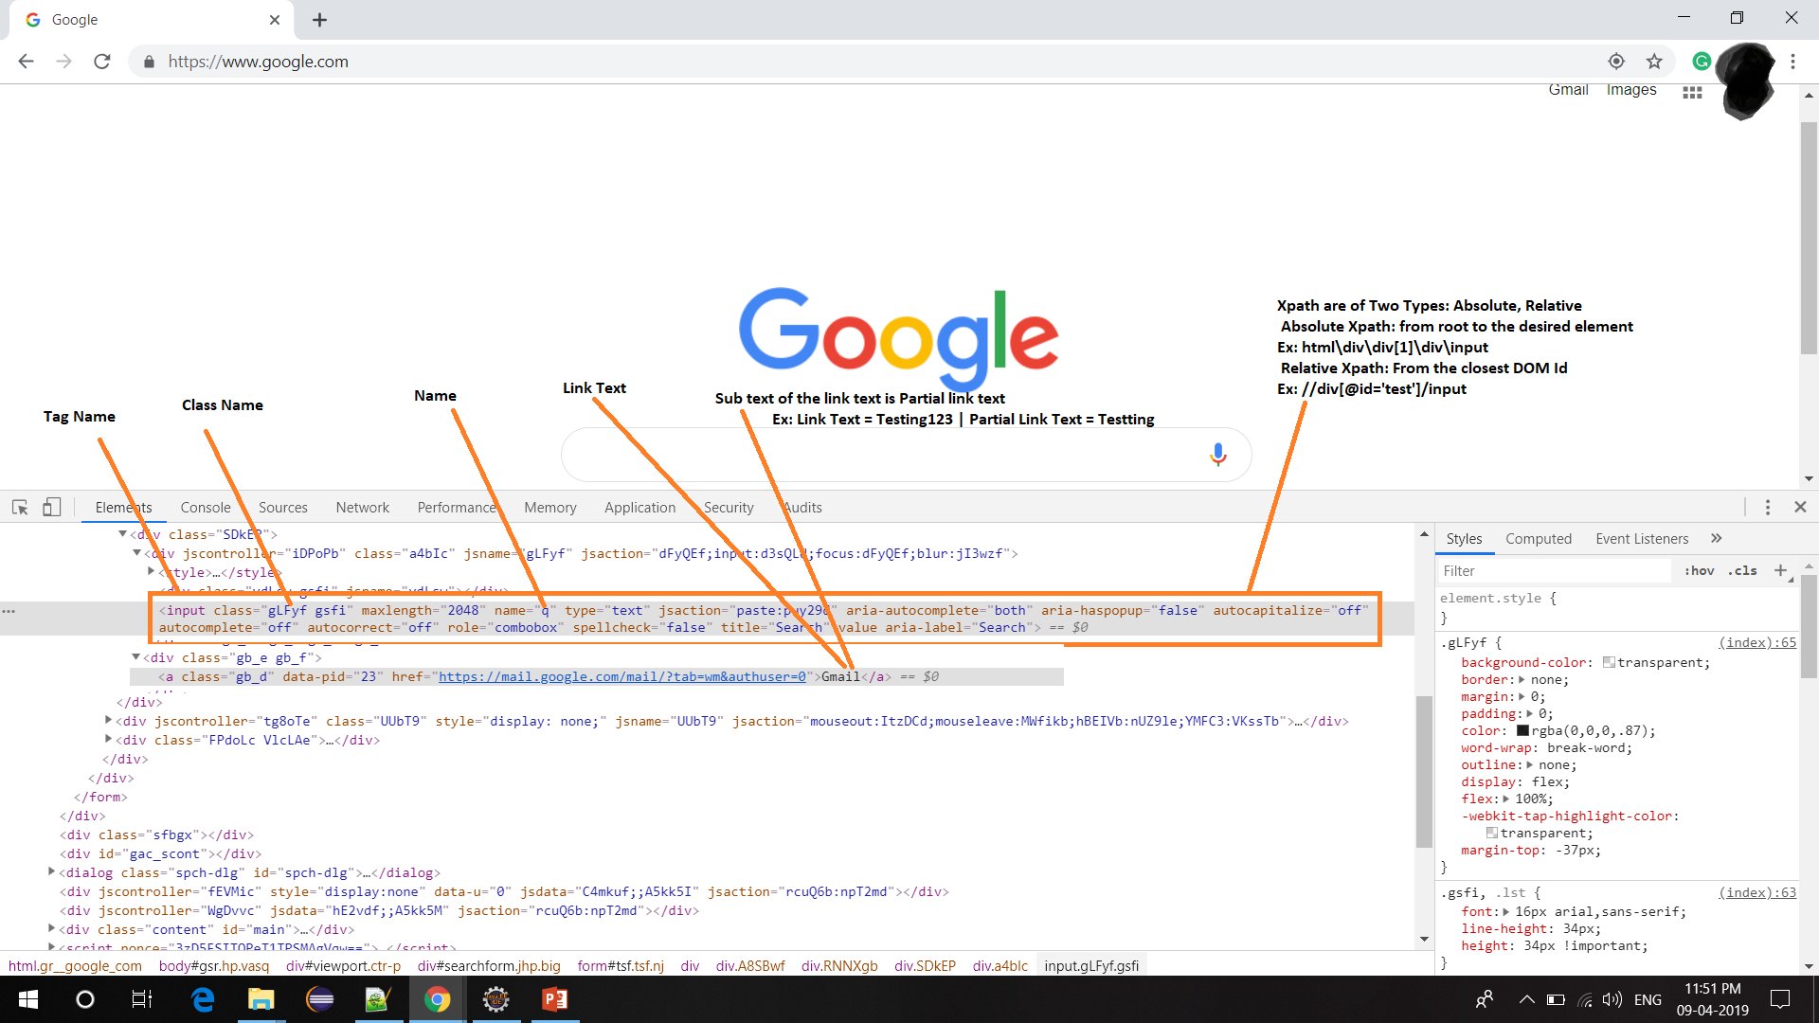
How to find element

Slide 7
Selenium Example
import time from selenium import webdriver driver = webdriver.Chrome('/path/to/chromedriver') # Optional argument, if not specified will search path. driver.get('http://www.google.com/xhtml'); time.sleep(5)
search_box = driver.find_element_by_name('q') search_box.send_keys('ChromeDriver') search_box.submit() time.sleep(5) driver.quit()

